Slide 1
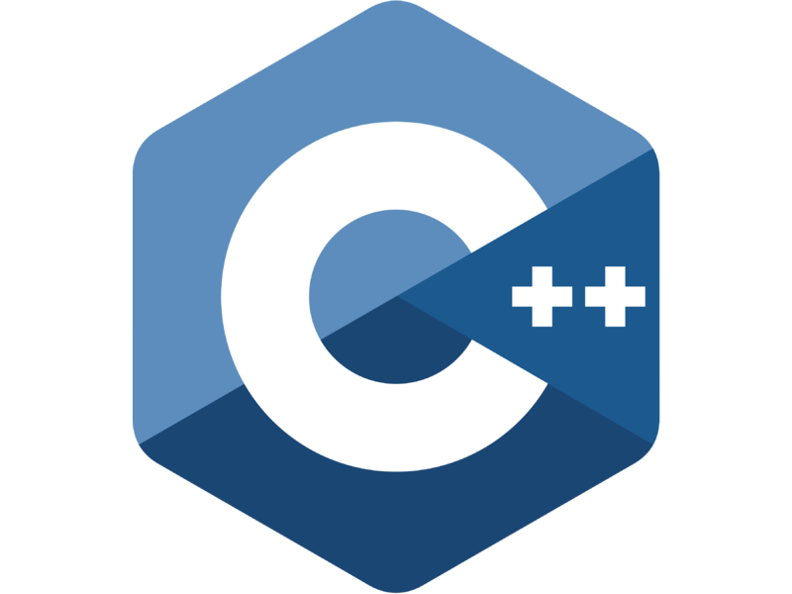

Loops
Kusal Bista

Slide 2
C++ Loop Types
There may be a situation, when you need to execute a block of code several number of times. In general, statements are executed sequentially: The first statement in a function is executed first, followed by the second, and so on.
A loop statement allows us to execute a statement or group of statements multiple times

Slide 3
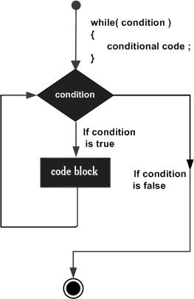
C++ while loop
A while loop statement repeatedly executes a target statement as long as a given condition is true.
while(condition)
{
statement(s);
}

Slide 4
C++ for loop
A for loop is a repetition control structure that allows you to efficiently write a loop that needs to execute a specific number of times.
Syntax:
for ( init; condition; increment )
{ statement(s);
}

Slide 5
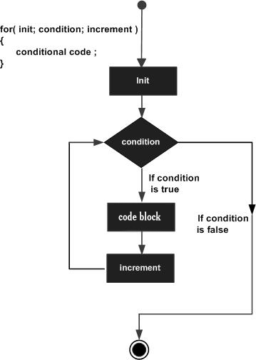
C++ for loop

Slide 6
C++ do...while loop
Unlike for and while loops, which test the loop condition at the top of the loop, the do...while loop checks its condition at the bottom of the loop.\
A do...while loop is similar to a while loop, except that a do...while loop is guaranteed to execute at least one time.
do {
statement(s);
} while( condition );

Slide 7
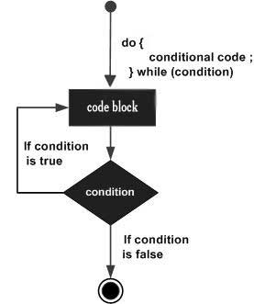
C++ do...while loop

